Slide 1
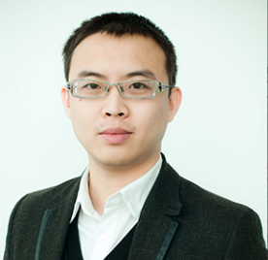
Dr. Qi Wu
Lecturer (Assistant Professor)
qi.wu01@adelaide.edu.au
School of Computer Science
The University of Adelaide
Adelaide, Australia

Slide 2
阿德莱德 Adelaide
https://www.adelaide.edu.au/
http://www.qi-wu.me/home.html
https://www.roboticvision.org/
阿德莱德（Adelaide），又译阿德雷德，澳大利亚第五大城市，也是南澳大利亚州首府，连续多年和墨尔本同时评为全世界最宜居的城市之一。
Rank | University | Country Name | Overall Score | Academic Reputation | Employer Reputation | Faculty Student | International Faculty | International Students | Citations per Faculty
114 | The University of Adelaide | Australia | 56.6 | 56.8 | 46.7 | 31.1 | 97 | 99 | 65.2

Slide 3
Dr. Qi Wu (吴琦) is a Lecturer (Assistant Professor) in the University of Adelaide and he is an Associate Investigator in the Australia Centre for Robotic Vision (ACRV). He is the ARC Discovery Early Career Researcher Award (DECRA) Fellow between 2019-2021. He was working with Prof. Anton van den Hengel, Prof. Ian Reid and Prof Chunhua Shen. Prior to joining the ACRV, Dr.Wu worked as a Senior Research Associate at the Australia Centre for Visual Technology (ACVT). He obtained his PhD degree in 2015 and MSc degree in 2011, in Computer Science from the University of Bath, United Kingdom. His educational background is primarily in computer science and mathematics. He is also the CTO of the Vismarty co. Ltd.
158 University of Bath United Kingdom
Working Experience:
Lecturer (Assistant Professor) at the School of Computer Science at the University of Adelaide. Australia, 2018 - present
ARC Senior Research Associate at Australia Centre for Robotic Vision (ACRV) at the University of Adelaide. Australia, 2017 - 2018（Peter Anderson新领域http://www.panderson.me/）
Senior Research Associate at Australia Centre for Visual Technology (ACVT) at the University of Adelaide. Australia, 2015 - 2017
Intern at Image and Visual Computing (IVC) Lab, Lenovo Research & Technology (R&T), Hong Kong & Shenzhen. Working with Dr. Li Xu. 2014.
Chunhua Shen 沈春華
https://cs.adelaide.edu.au/~chhshen/
From 2006 to 2011, I held an adjunct position at College of Engineering & Computer Science, Australian National University. I moved back to University of Adelaide in 2011.
Notes:
吴琦博士是阿德莱德大学的讲师（助理教授），也是澳大利亚机器人视觉中心（ACRV）的副研究员。 他是2019年至2021年间ARC发现早期职业研究员奖（DECRA）研究员。 他与Anton van den Hengel教授，Ian Reid教授和沉春华教授合作。 在加入ACRV之前，吴博士曾在澳大利亚视觉技术中心（ACVT）担任高级研究员。 他于2015年获得博士学位，并于2011年获得英国巴斯大学计算机科学硕士学位。 他的教育背景主要是计算机科学和数学。 他也是Vismarty公司的首席技术官

Slide 4
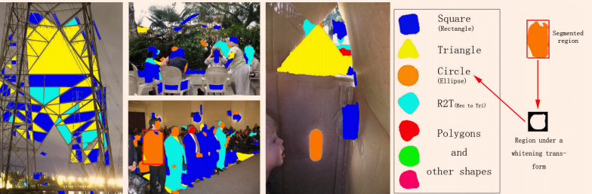
吴琦博士研究方向是visual object
Hongping Cai, Qi Wu and Peter Hall. Beyond Photo-Domain Object Recognition: Benchmarks for the Cross-Depiction Problem, In Proceedings of International Conference on Computer Vision (ICCV 2015) Workshop, 2015, (second best paper award).
Qi Wu, Hongping Cai and Peter Hall. Learning Graphs to Model Visual Objects across Different Depictive Styles. In Proceedings of European Conference on Computer Vision (ECCV 2014), 2014.
Qi Wu and Peter Hall. Modelling Visual Objects Invariant to Depictive Style. In Proceedings of the British Machine Vision Conference (BMVC 2013), 2013.
Qi Wu and Peter Hall. Prime shapes in natural images. In Proceedings of the British Machine Vision Conference (BMVC 2012), pages 45.1-45.12. BMVA Press, 2012.

Slide 5
Vision and Language
2018 | (TMM), 2018. (TPAMI), 2018. (IF: 9.455)
 | 6CVPR (MICCAI 2018), 2(AAAI 2018) (ECCV 2018), 2018.
2017 | 2TPAMI IEEE Signal Processing Magazine (SPM) Computer Vision and Image Understanding (CVIU)
 | International Joint Conference on Artificial Intelligence (IJCAI 2017), 2017. (CVPR 2017), 2017.

Slide 6
https://lvatutorial.github.io/
Vision-Language-Action tutorial

